Slide 1

DC-DC Converter for PV Module Integration
Group 760

Slide 2

CONTENT
INTRODUCTION
CONVERTER DESIGN
MPPT ALGORITHM
TESTS RESULTS
DISCUSSION
CONCLUSION

Slide 3
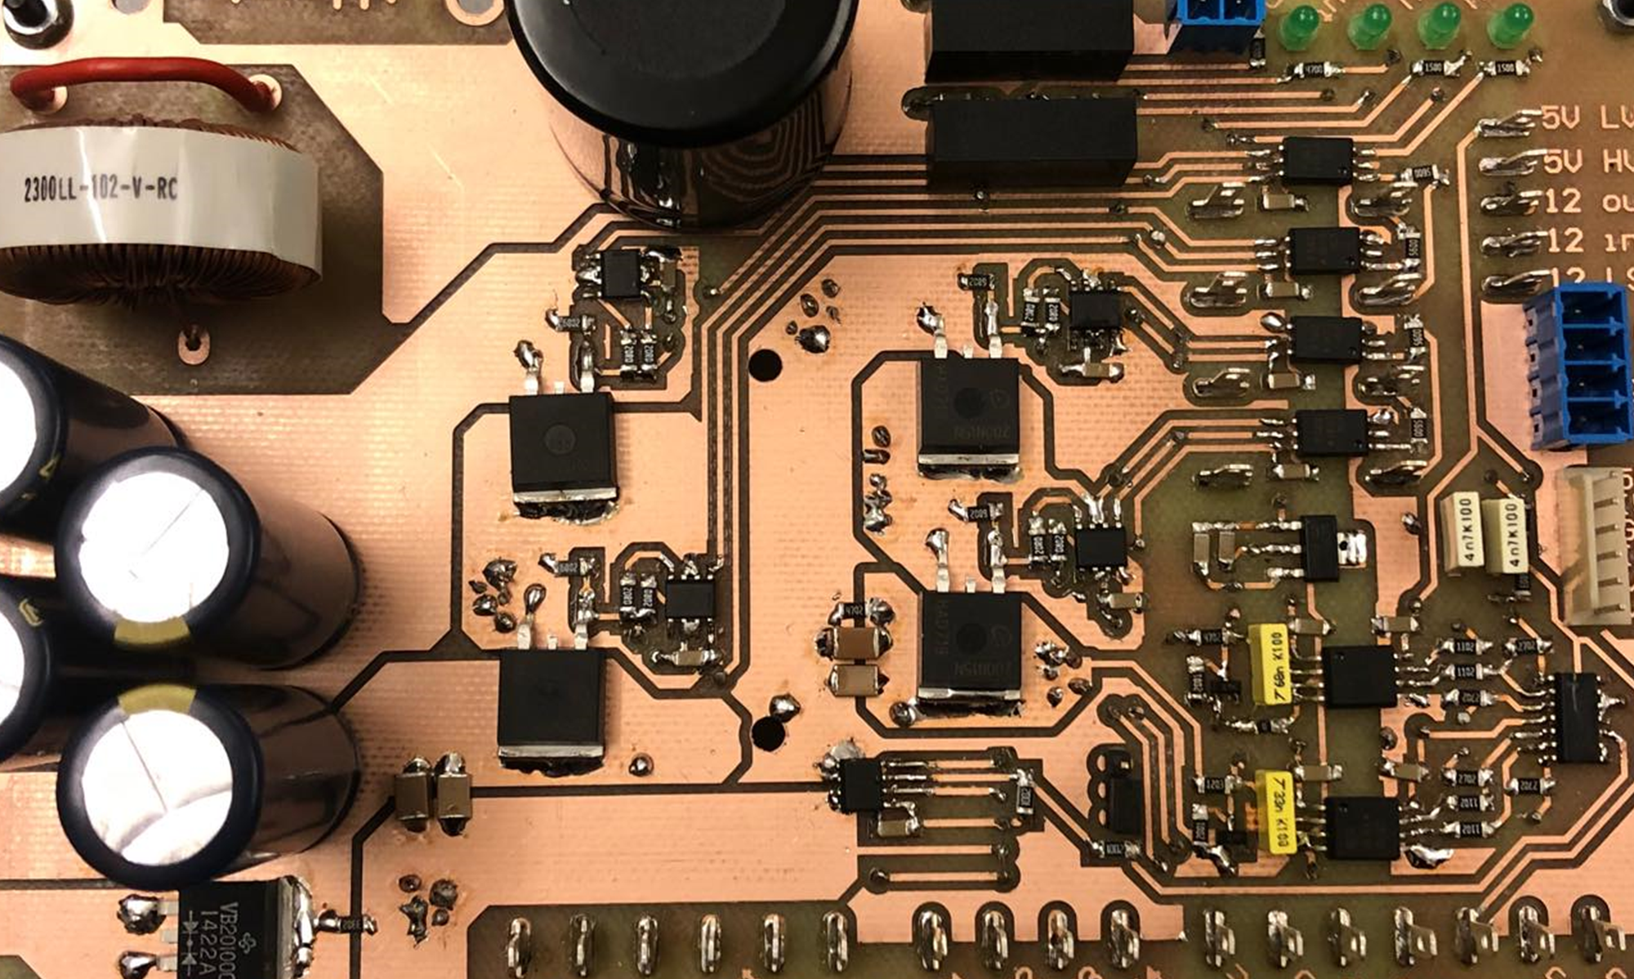
Introduction
Notes:
Motivation
Existing problems
What is a MIC
Why a MIC
Problem statement

Slide 4
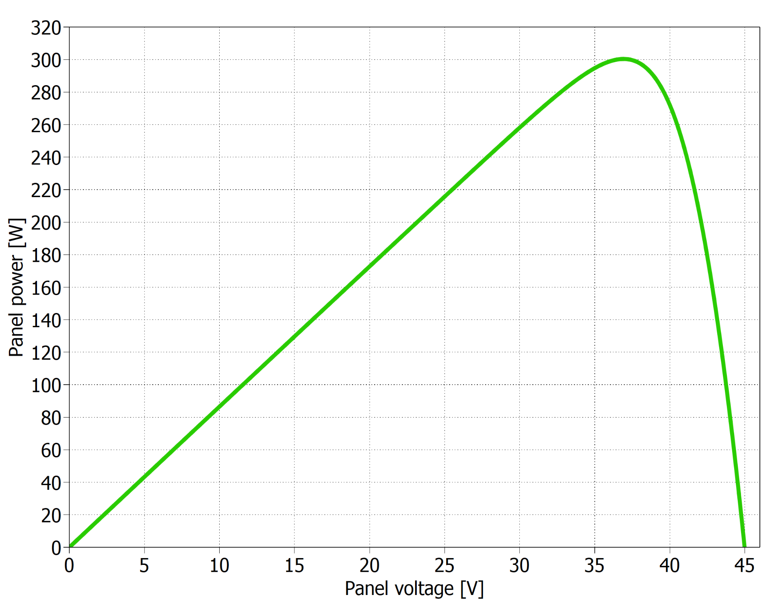
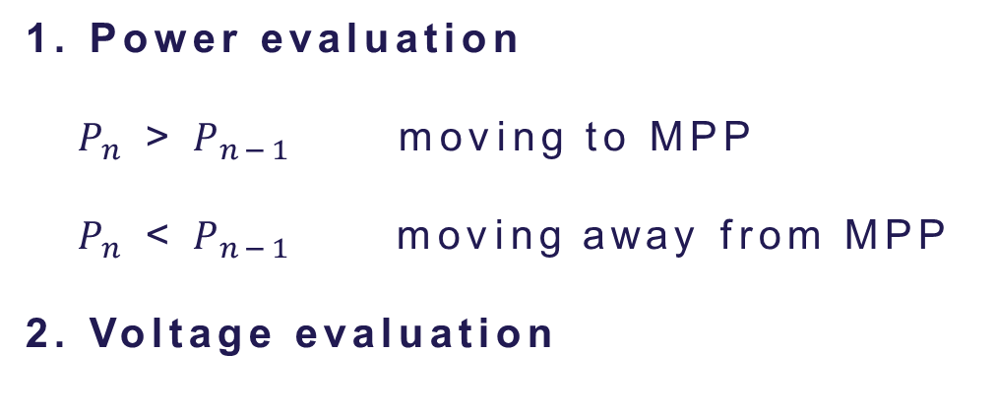
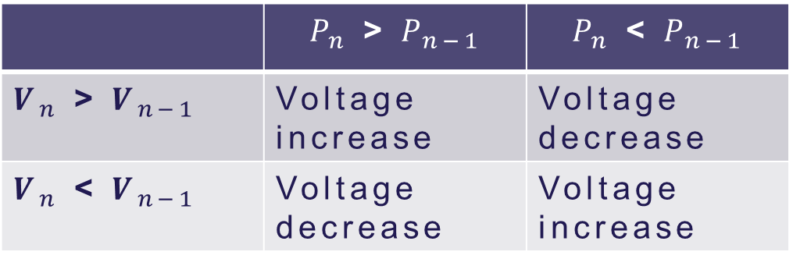
Perturb & Observe technique
Slide
of 59
1. Power evaluation
$P_{n}$ > $P_{n−1}$ moving to MPP
$P_{n}$ < $P_{n−1}$ moving away from MPP
2. Voltage evaluation
 | $P_{n}$ > $P_{n−1}$ | $P_{n}$ < $P_{n−1}$
$V_{n}$ > $V_{n−1}$ | Voltage increase | Voltage decrease
$V_{n}$ < $V_{n−1}$ | Voltage decrease | Voltage increase
P-V curve from a PV panel
Thassilo

Slide 5
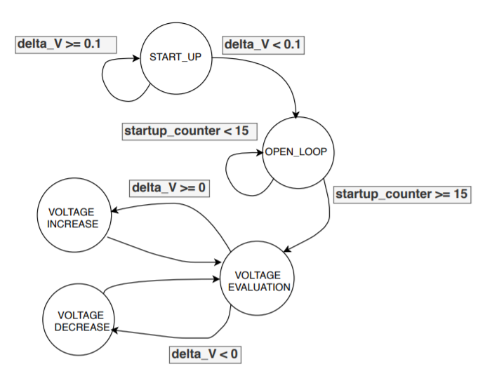

Initial MPPT implementation
Slide
of 59
Problems:
“If/else” structure difficult to find errors.
Variable step required more complex code.
Finite state machine for P&O algorithm
Thassilo

Slide 6
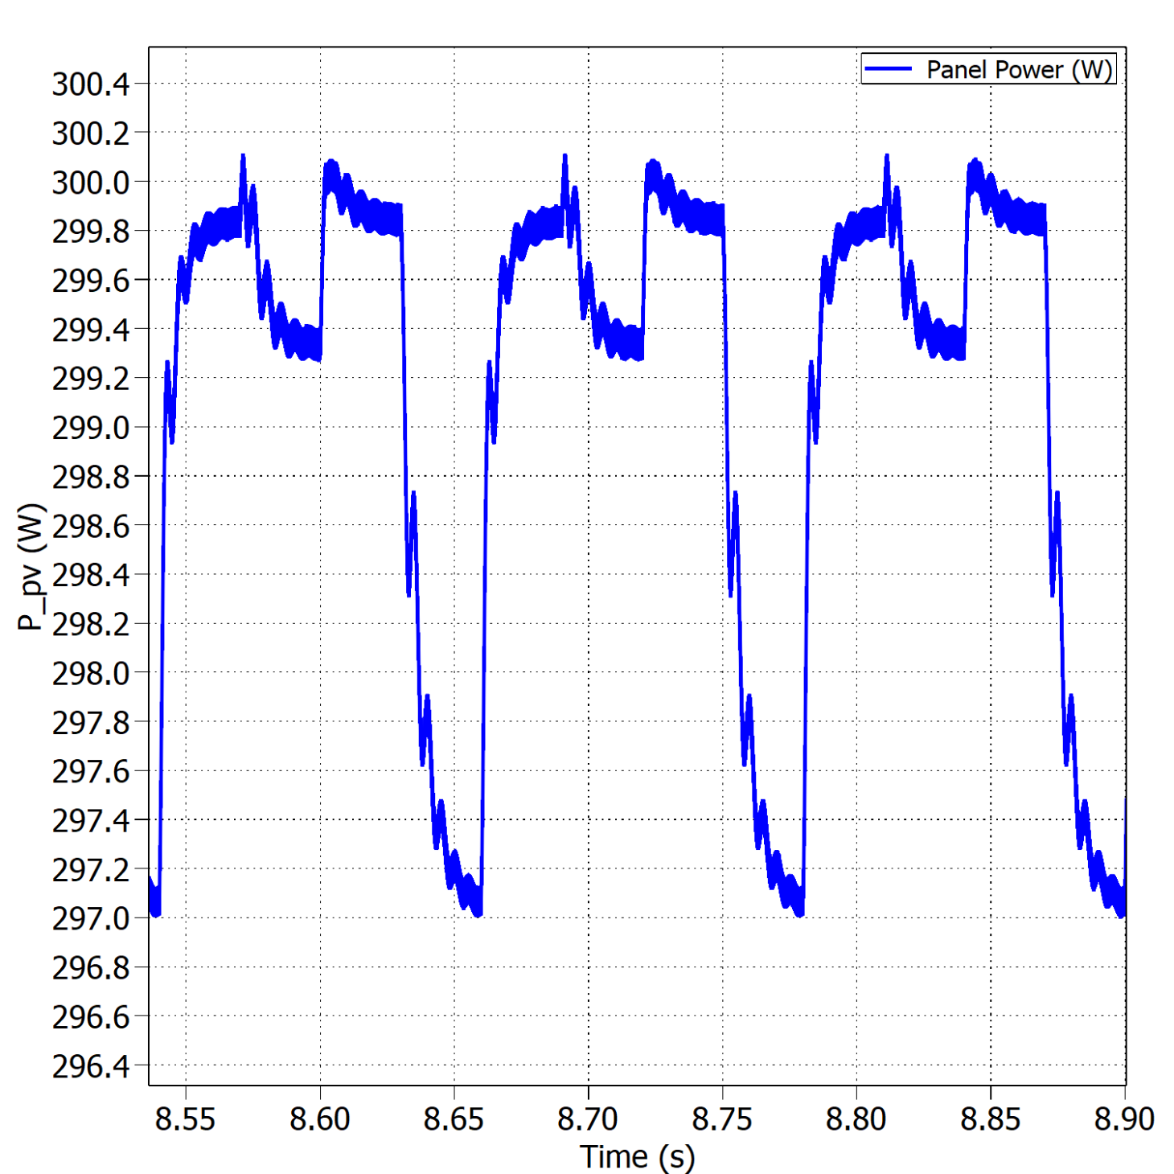
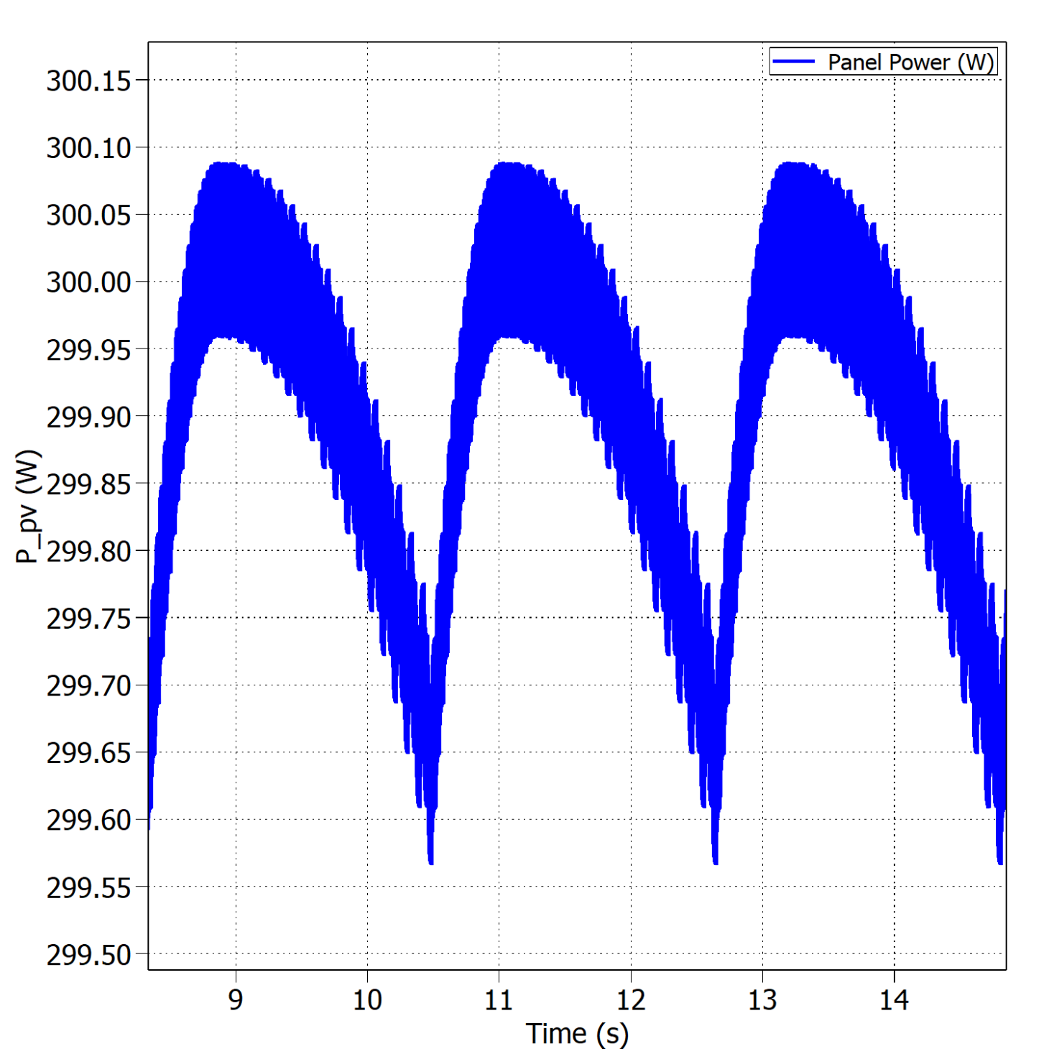


Fixed vs variable perturb step – Buck
Slide
of 59
Oscillations around the MPP with fixed perturb step under STC.
Oscillations around the MPP with variable perturb step under STC.
$$η_{MPPT}=99.38\%$$
$$η_{MPPT}=99.96\%$$
Thassilo

Slide 7
Future work
Slide
of 59
Hardware improvements.
Inductor design.
PCB optimization.
Converter’s efficiency.
V/I controller.
Thassilo

Slide 8

Thank you for your attention
Questions?
[5]

Slide 9
References
[1] http://www.safegardgroup.com/blog/2017/07/27/solar-panel-disposal
[2] https://www.dgem.nl/nl/zonne-energie/opbrengstvariabelen-zonnepanelen
[3] http://www.alternative-energy-tutorials.com/energy-articles/solar-cell-i-v-characteristic.html
[4] MOSFET Gate Drive Circuit, Toshiba, 2018
[5] https://www.thermofisher.com/blog/mining/mining-metals-for-a-renewable-energy-future/

